Slide 1




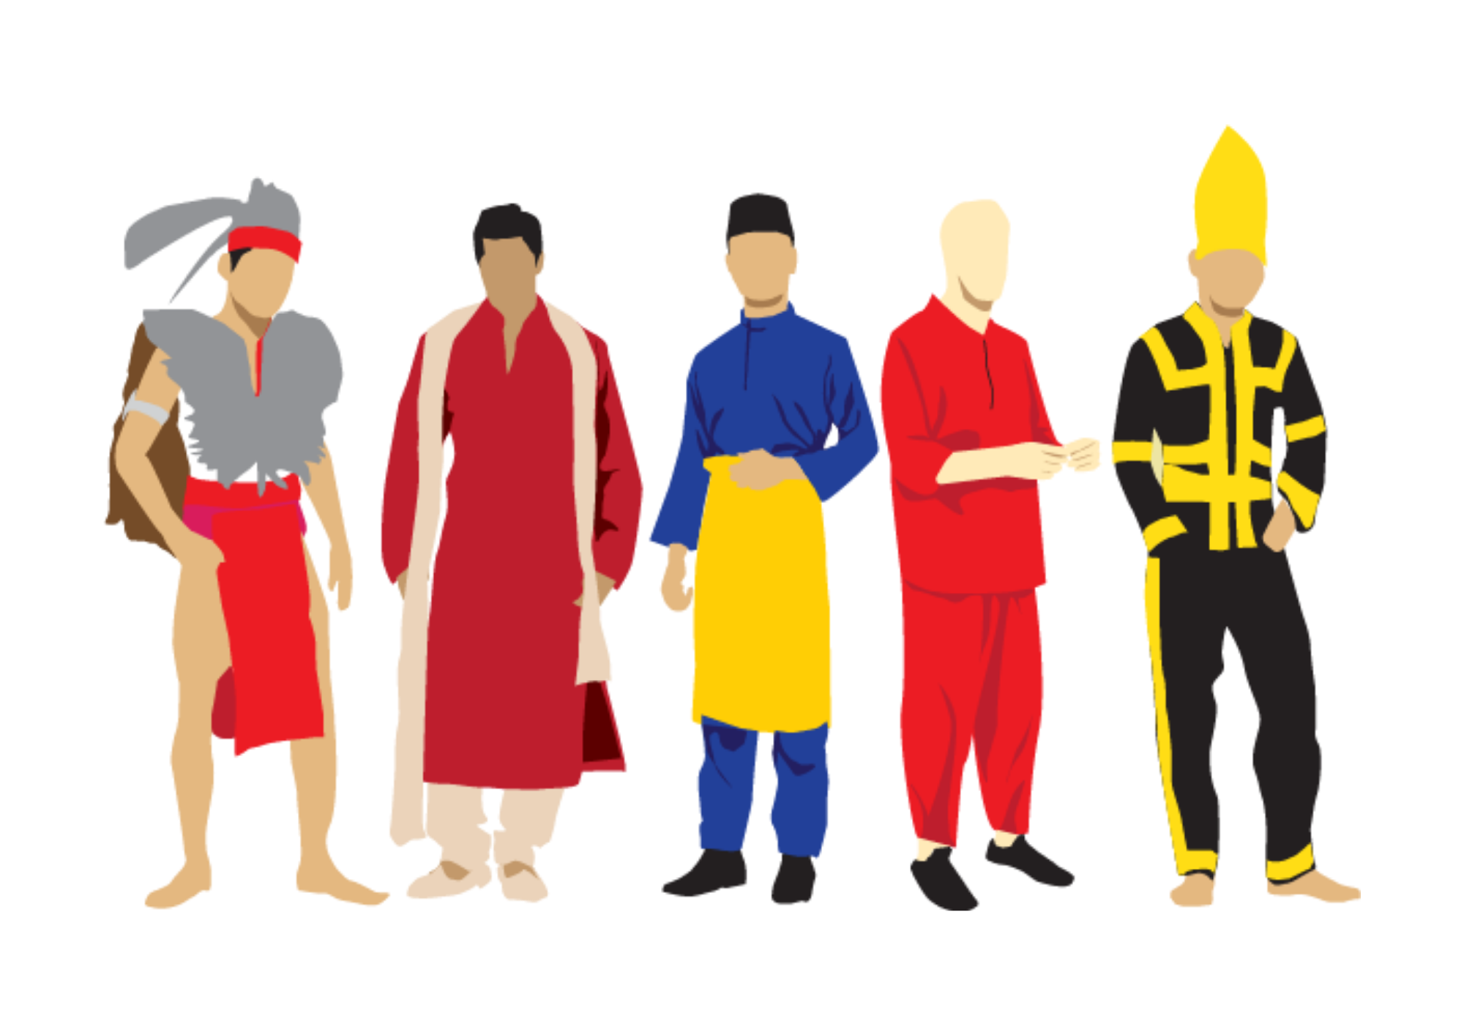

A CHILD’S DREAM
MERDEKA in my dream
Right or wrong, true or false,
May be I am wrong,
I saw Merdeka in my dream.
I saw birds flying and singing in the air,
I saw clouds shadowing the sky,
I saw the sunrise brightening the day,
I saw people dancing and merry-making,
I saw an atmosphere of peace surrounding me,
I saw Malaysia as a developed nation.
I wish my dream is true,
Or, I keep my dream in my lonely heart
Be there as my sweet memory.

Slide 2
A CHILD’S DREAM
MERDEKA in my dream
Right or wrong, true or false,
May be I am wrong,
I saw Merdeka in my dream.
I saw birds flying and singing in the air,
I saw clouds shadowing the sky,
I saw the sunrise brightening the day,
I saw people dancing and merry-making,
I saw an atmosphere of peace surrounding me,
I saw Malaysia as a developed nation.
I wish my dream is true,
Or, I keep my dream in my lonely heart
Be there as my sweet memory.

Slide 3



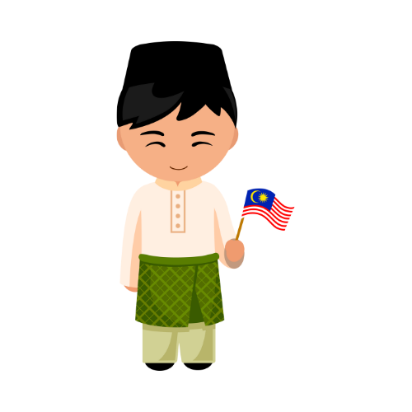
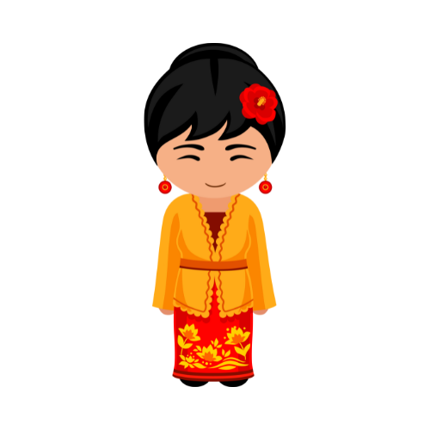
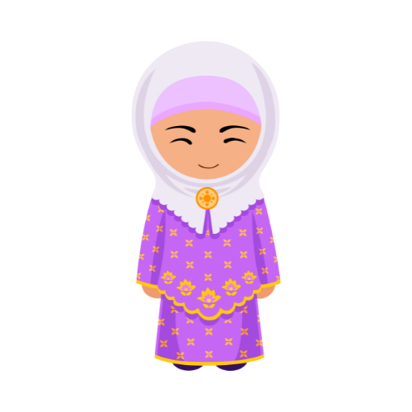
THIS IS THE DAY
This is the day we celebrate our independence.
This is the day we stand up high in pride.
This is the day we fly our flag of freedom from east to west,
That brings courage, liberty, purity, perseverence, and justice to our minds.
This is the day we remember those who fought for independence
Without shedding a drop of blood.
This is day we pray for the prosperity and progress of the Nation
This is the day we tell the world
That we live in peace, harmony, and brotherhood.

Slide 4

THIS IS THE DAY
This is the day we celebrate our independence.
This is the day we stand up high in pride.
This is the day we fly our flag of freedom from east to west,
That brings courage, liberty, purity, perseverence, and justice to our minds.
This is the day we remember those who fought for independence
Without shedding a drop of blood.
This is day we pray for the prosperity and progress of the Nation
This is the day we tell the world
That we live in peace, harmony, and brotherhood.

