Slide 1



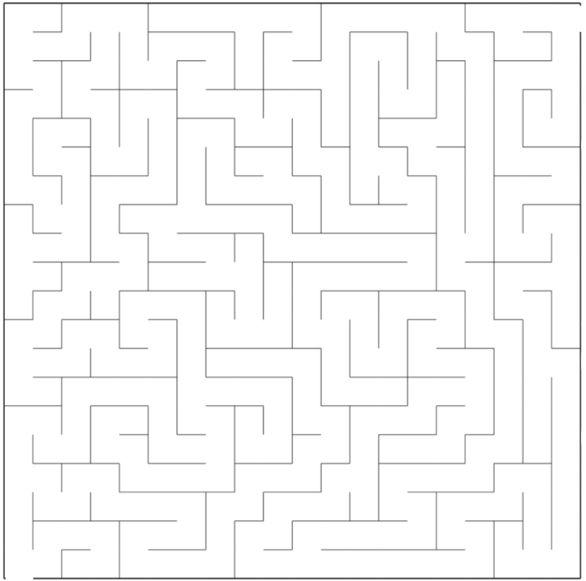
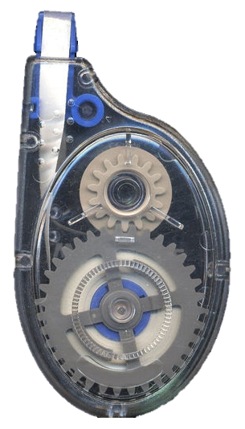

Help Mariam to find her Correction Tape
Maze 20
MINUTES

Slide 2
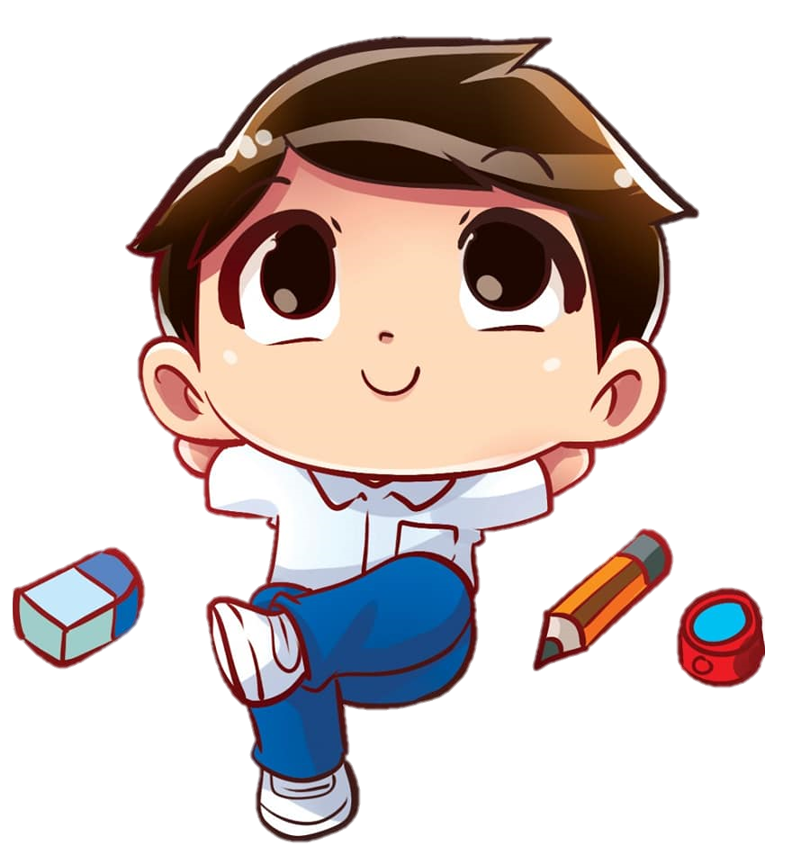
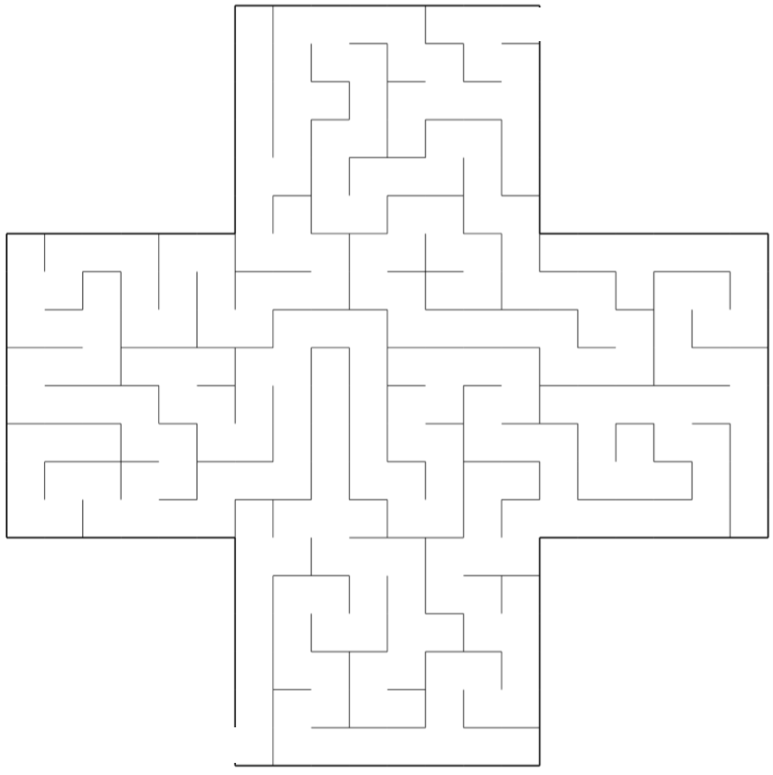

Help David to find his Glue
Maze 21
MINUTES

